Slide 1
DHIS2 Event Report Widget Bridging Dashboards with Event-Level Data
Presented by:Mamadou Tafsir Diallo
Solution Architect
International Committee of the Red Cross (ICRC)

Slide 2
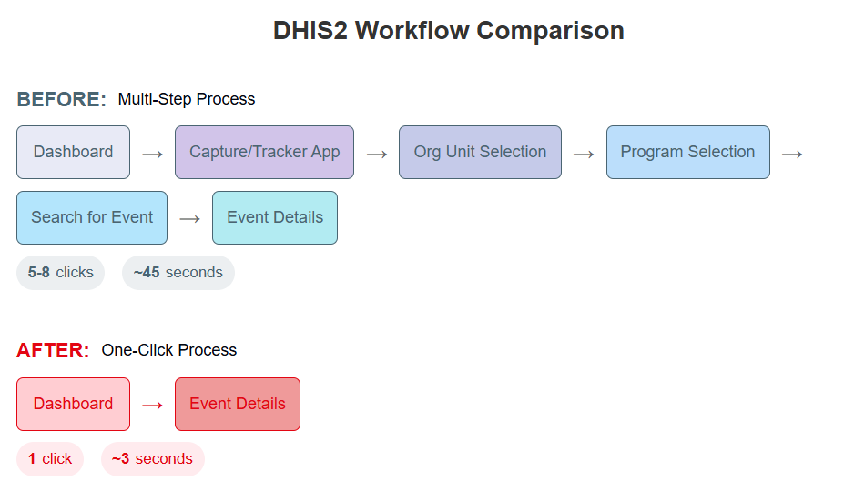
The Challenge
Current DHIS2 Workflow Challenges
Problem:
Dashboards show list of events, but accessing individual events requires multiple steps
Field staff must navigate away from dashboards to investigate specific events
Typical workflow requires 5-8 clicks and navigation through multiple screens
Time-consuming process reduces data use and follow-up actions

Slide 3
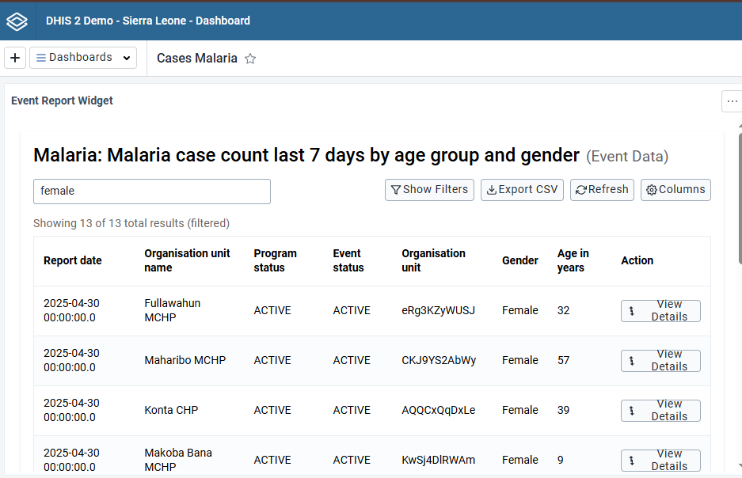
The Solution
Key Features:
Embeds event reports directly in DHIS2 dashboards
One-click access to events in Tracker or Capture app
Automatic detection of appropriate destination app
Interactive filtering, searching, and sorting
Customizable columns for different use cases
Dashboard-specific configurations
Benefits:
80% reduction in clicks to access event details
Streamlined workflow for field staff

Slide 4
Demonstration Overview
What You'll See Today
1. Configuration
How to select and configure event reports for dashboards
Customizing the display for different team needs
2. User Experience
Viewing event data directly in dashboards
Finding specific events with search and filters
One-click access to event details in Tracker/Capture
3. Implementation Benefits
How the widget improves field operations
Real-world usage in ICRC programs

